Slide 1
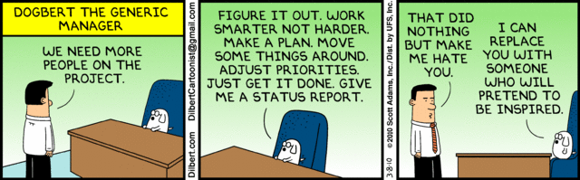
Introduction to Software Project Management
Phil Pfeiffer
Fall, 2014

Slide 2

Definition of Management
A mental process of
establishing,
and then indirectly achieving,
the right objectives
in the right priority sequence
with a sufficient amount of resources.

Slide 3
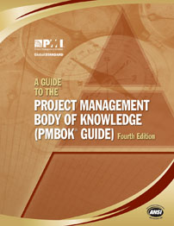
Definition of a Project
a temporary endeavor
undertaken to create
▪ a unique product,
▪ service
▪ or result

Slide 4


Importance of Software Project Management
Second most important process in IS, after operations
▪ Operations deliver value that's already been created
▪ Projects deliver new value
Bob Lewis, former InfoWorld columnist

Slide 5
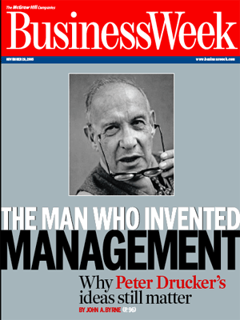
Challenges of Management
An "unnatural act" (Suters)
▪ Maintaining dual focus
▪ most important: tomorrow
▪ most pressing: today
▪ Achieving results through others
▪ Thinking through difficulties
▪ Accepting hostility as outcome of proper action
Skills "not inborn" (Drucker)
▪ Effective executives learn what to do, then
▪ Practice effectiveness until
it becomes habit

Slide 6

Challenges of Software
Proj. Mgmt.
(Bob Lewis)
Hardest job in Information Systems
▪ Harder than CIO, dept. mgr., data center mgr.
▪ Requires conflicting skills
▪ Vision + attention to detail
▪ Empathy + strictness
Biggest failing in most IS depts.
▪ Few projects flat-out succeed (< 30%?)
▪ Many succeed only due to redefinition of scope

Slide 7
Project Management and You
Your effectiveness as an IT professional will depend, in (large) part, on
▪ your manager's ability to manage you…
▪ your ability to manage yourself
If you work in one position for long enough, you may be asked to manage

Slide 8
Project Mgmt. Can Be Learned
Hordes of texts say so
Technical skills
▪ Managing project scope, requirements, schedule, cost, quality, process, human resources, communications, risk, procurement, and integration processes
Soft (people) skills
▪ Communication, leadership, team building, motivation, influencing, decision making,
political and cultural awareness, negotiation

Slide 9
Classic (e.g., PMBOK) Assumptions about Organizational Culture
Top mgmt.
defines organization's mission
develops strategic plan for mission
uses management by objective (MBO) to implement strategic plan
▪ strategic plan reified as set of measurable objectives
▪ achieving objectives delegated to mid-level mgmt.
▪ objectives hierarchicalized for manageability
▪ granularity: portfolios, programs, projects

Slide 10
Portfolios, Programs, Projects
Portfolio
▪ set of artifacts that (should) have related objective(s)
▪ can include programs, projects, and other work
Program
▪ set of artifacts that (should) have one cohesive objective
▪ can involve operations as well as projects
Project
▪ possible reasons for undertaking projects: compliance, opportunity
▪ possible business cases: market demand, organizational need, customer request, technological advance, legal requirement, sustainability, social impacts

Slide 11

Rough Example: ETSU's
College of Business and Technology
Mission: deliver courses on business and technology
▪ not cohesive, but that happens
Portfolio
▪ Departments (e.g., ECON, MGMK, TECH)
▪ Centers (e.g., Career Services)
▪ Committees (e.g., graduate, honors)
Sample "program": CSCI
▪ CSCI program operations
▪ grad and undergrad concentrations
▪ centers (PASTA, ETC)
▪ committees
▪ CSCI program projects
▪ replacing faculty lost to attrition
▪ establishing track for health-related informatics

Slide 12
PMBOK Assumptions: Project Selection
Doing projects - a must
▪ Doing nothing = stagnation, decline
Selecting what to do - a must
▪ More projects to do than resources
Done by economic criteria
▪ determine what must be done, due to regulations
(i.e., compliance)
▪ estimate value of others
▪ value = benefit - cost
▪ benefits include avoidance of penalties
▪ costs include missed opportunities (opportunity cost)
▪ prioritize by value
Sometimes done by project management office (PMO)

Slide 13
Starting Points for Project Mgmt: Project Commonalities
Every project
▪ should be initiated in response to a need
▪ whether documented or not
▪ has a charge
▪ whether documented or not
▪ proceeds in phases
▪ exhibits a standard pattern of resource usage
▪ becomes rigid over time
▪ requires ongoing planning to succeed

Slide 14
Project Commonalities: Inception
Assumption: every project initiated in response
to a need re: its host organization's mission
PMBOK assumes this need will be documented in a statement of work (SOW)
▪ Needs that business intends to address
by this project
▪ including relationship to strategic plan
▪ Project's scope
▪ deliverables' key attributes (high-level requirements)
▪ how these attributes address these business needs

Slide 15
Project Commonalities: Charge
Assumption: every project has requirements, and a proper scope of authority for meeting them
This charge, according to PMBOK, should be documented in a project charter
▪ Roughly speaking, an extension of the SOW, with
▪ Measurable project objectives, success criteria
▪ Risks
▪ Schedule
▪ Budget
▪ Requirements for approval
▪ Key personnel (e.g., manager(s), sponsor(s))

Slide 16
Project Commonalities: Requirements
Define project's deliverables: a combination of
▪ products - e.g., a payroll application
▪ services - e.g., a help desk
▪ results - e.g., a feasibilty study's content
Done at different levels of precision: e.g.,
▪ vision statement
▪ documents deliverables' importance by briefly stating what it should do
▪ high-level requirements
▪ describes functions the deliverable shall provide
▪ low-level requirements (a.k.a. specification)
▪ describes how the deliverable presents itself to its users
i.e., appearance, detailed characterization of user interactions
Vague distinctions mirror vagueness in literature

Slide 17
Project Commonalities:
Resolving Competing Interests
Competition over limited pool of resources
▪ Within projects - different stakeholders typically want different outcomes
▪ including, sometimes, project failure
▪ Between projects - different projects compete for
common pool of resources
Characterized as competing constraints

Slide 18
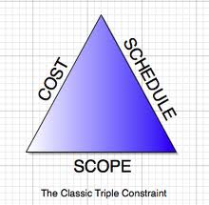
The Triple Constraint
Classic goals for project completion
▪ keep costs low
▪ monetary costs (budget)
▪ resource costs
(e.g., personnel)
▪ maximize functionality
▪ feature set
▪ feature quality
▪ accelerate completion
These three goals compete
▪ emphasizing any two
slights the third

Slide 19
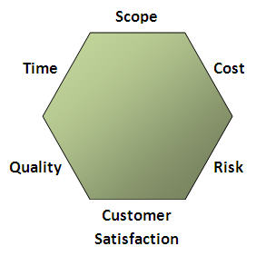
Constraints: More Precise Formulations
PMBOK (cf. 1.3) names six constraints:
▪ scope, quality, schedule,
budget, resources, risk
Depicted here: a variant
▪ budget and resources
collapsed to cost
▪ customer satisfaction added
"Sextuple constraint"
not as cool-sounding as
"triple constraint"
Both expected for PMP
Source: http://thecriticalpath.info/2008/10/05/triple-constraint/

Slide 20
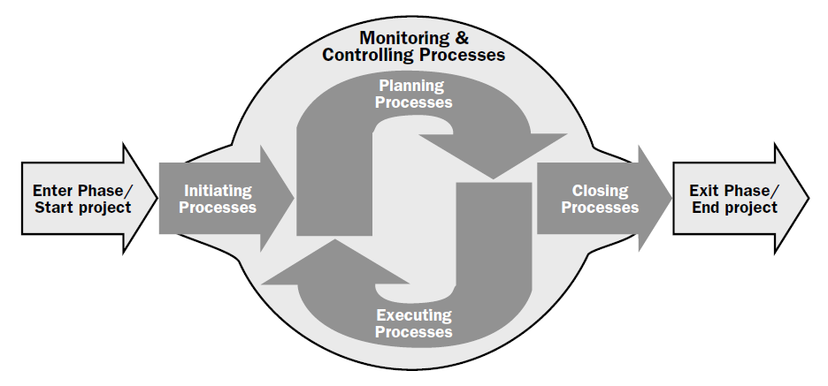
Project Commonalities:
Phased Lifetimes
Phase: division where extra control needed to manage a major deliverable's completion
PMBOK identifies five kinds of intra-phase processes

Slide 21
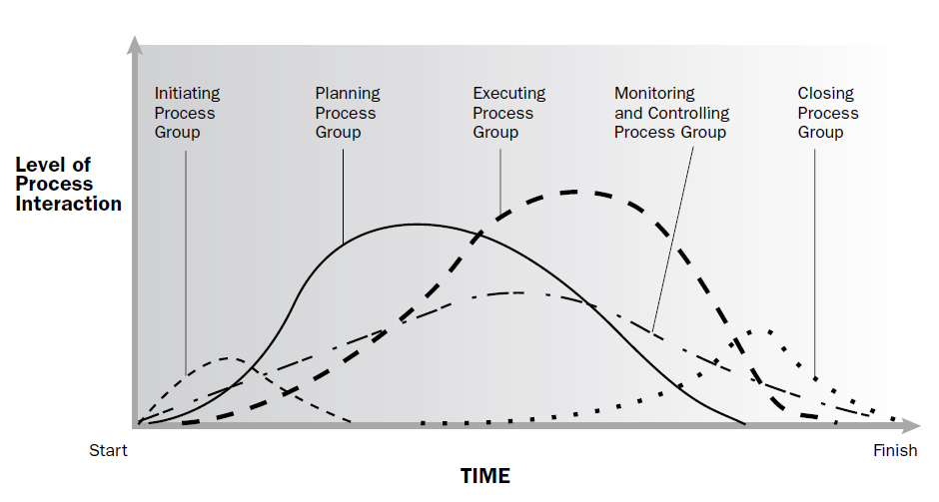
Project Commonalities:
Intra-Phase Process Interaction

Slide 22
Project Phase Divisions
PMBOK identifies three basic phase-to-phase relationships for multi-phase projects
▪ sequential
▪ multiple phases planned in advance
▪ phase N+1 starts after N finishes
▪ reduces threat of rework, but increases time to deliver
▪ overlapping
▪ multiple phases planned in advance
▪ phase N+1 starts before N finishes
▪ speed development, but increases risk of rework
▪ iterative
▪ phase N+1 planned after N finishes
▪ reduces potential cost of failure by allowing for incremental reevaluation of resources, based on potential cost-benefit

Slide 23
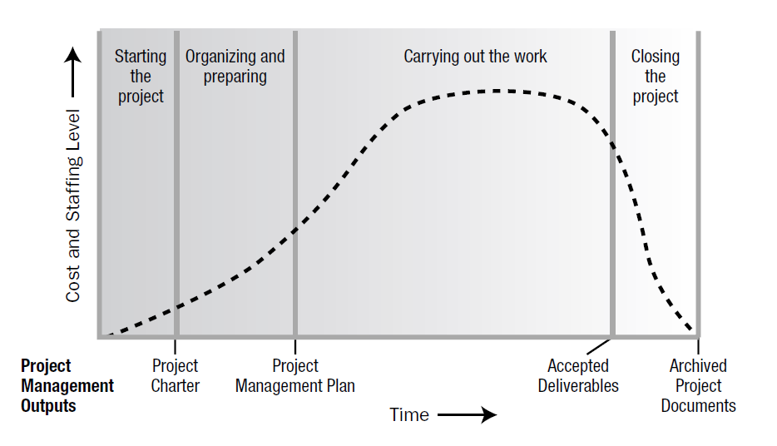
Project Commonalities:
Resource Usage

Slide 24
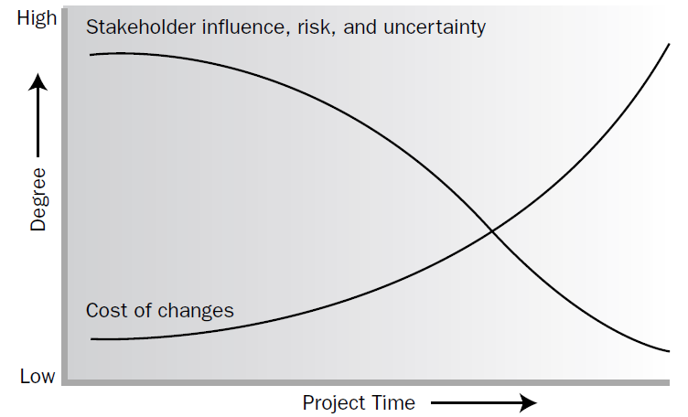
Project Commonalities:
Increasing Rigidity over Time

Slide 25

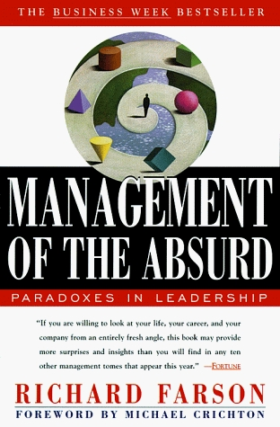
Project Commonalities: Ongoing Planning
Planning is in every PMBOK phase
Assessment of planning's value
▪ Everett Suters, Unnatural Act of Mgmt.
▪ process more important than the plan
▪ test if objectives can be achieved
▪ Richard Farson, Mgmt. of the Absurd
▪ built on the flawed idea that people can predict the future
▪ future almost always a surprise
▪ crucial, however, for
▪ assessing the present
▪ remaining alert to the unexpected

Slide 26
Starting Points for Project Mgmt: Project Differences
No one best strategy (model, set of processes) for project lifecycle
▪ Effectiveness of models, strategies varies, due to
varying project characteristics, environmental factors
▪ Project size, criticality, continuity of staffing
▪ Organizational culture, structure, process assets
For any given project, the project manager, in collaboration with the project team, is always responsible for determining which processes are appropriate, and the appropriate degree of rigor for each process. -- PMBOK, pref. to chp. 3

Slide 27
PMBOK Project Manager Skill Set a.k.a. Knowledge Areas
scope management - how much?
time management - how long?
cost management - how expensive?
quality management - how well?
human resource management - parenting, influencing
communications management - informing
risk management - managing uncertainty
procurement management - getting supplies
integration management - combining the above

Slide 28
PMBOK Presentation of Skill Sets
Intimidating – at least to me
▪ 193 figures
▪ 42 processes across
45 knowledge area-process group pairings
▪ The PMP exam does complete coverage of PMBOK
What you should know
▪ For the PMP exam, most or all of it
▪ For this class,
▪ key principles (as per these slides)
▪ a few lists, with some computing-specific material

Slide 29
PMBOK Complexity: My Take
Checklists are classic tools for avoiding errors of omission
▪ Used by NASA, boy scouts, insurers, dive training agencies, fire departments, lifeguards, and hospitals, to name a few
Follow the PMBOK's recommendation - think "checklists":
▪ From Chapter 3:
Project managers and their teams should carefully address
each process and its constituent inputs and outputs. This
chapter should be used as a guide for those processes they
must consider in managing their project.
▪ From Chapter 4:
[T]he perception that a particular process is not required does not mean that it should not be addressed. The project manager and project team must address every process to determine the level of implementation for each process for each project.

